Slide 1
MINDSPACE
Team Name: JARVIS
Amruta Patil
Nidhi Goyal
Priyanka Pal

Slide 2
Problem Statement
Mobile mental health support can be very simple but effective. This new era of mental health technology offers great opportunities but also raises several concerns. Tackling potential problems will be an important part of making sure that the application provide benefits without causing harm where the user puts information into the application so that the application can provide feedback and help user with cognitive remediation with additional support.

Slide 3

MindSpace Mental HealthCare
Goals And Objective
This Java Swing application aims to maximizing their potential to increase public self-management of mental care
Our objective is to provide an electronic means for recording, communicating, and processing all data produced in the context of the mental health care process of patients

Slide 4
Problems to be Addressed
Mental health is a sensitive subject requiring a special approach
An app’s design may alienate users, or in-app mechanisms may not motivate them enough to overcome a mental health problem
Users might also abandon an app if they feel they aren’t receiving the support they expect. The list of possible issues goes on and on.

Slide 5
Need of an application:
Treatment can take place anytime and anywhere and may be ideal for those who have trouble with in-person appointments.
Clients can seek treatment options without involving other people.
Technology can complement traditional therapy by extending an in-person session, reinforcing new skills, and providing support and monitoring
May be a good first step for those who have avoided mental health care in the past.

Slide 6
KEY ACTORS:
System Admin
Enterprise Admin
Doctor
Lab Assistant
Pharmacist
NGO Staff
NGO Supervisor
Event Organizer
Patient

Slide 7
USE CASES:
Patient Domain:
Have an option to sign-up
Have an option to create and update profile through dashboard feature
Option to take right test based on health and mental condition
Can get guided recommendation based on test and score obtained
Have an option to book an appointment for a doctor
Can get prescription suggested by doctors and confirmed by pharmacist
Have an option to register of events and seminar

Slide 8
USE CASES:
Doctor Domain:
Have an option to sign-up
Can checks Patient history and Appointment schedule on dashboard
Attending Patient
Request Patient Test to Lab Assistant
Prescribes Medicines to Patient based on the test taken by Patient
Sends request to Pharmacist for Patient medicines

Slide 9
USE CASES:
Lab Assistant Domain:
Have an option to sign-up
Performs Test of Patient suggested by doctor
Sends Test status to doctor
Pharmacist Domain:
Have an option to sign-up
Takes work assigned by doctor to himself.
Process the prescribed medicines by doctor to patient for pick-up
Changes the status of medicines ordered

Slide 10
USE CASES:
NGO Supervisor Domain:
Have an option to add new event details
Send event details to NGO staff
NGO Staff Domain:
Have an option to assign event to particular event organizer
NGO Event Organizer Domain:
Gets all the details from NGO staff which needs to be organized

Slide 11
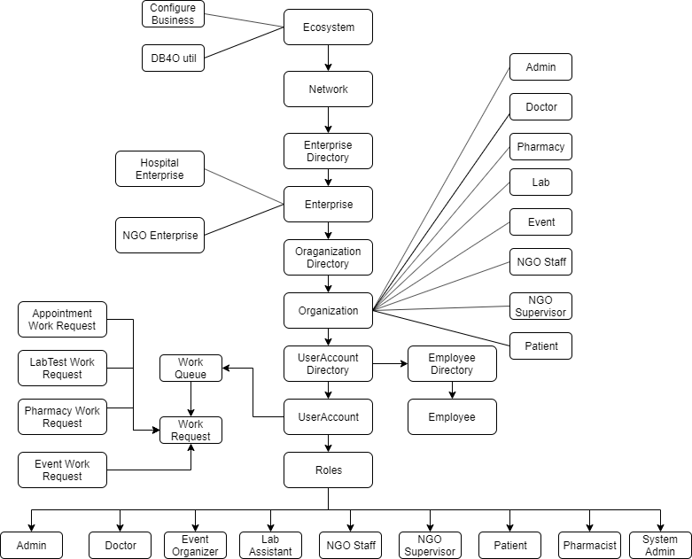
ECOSYSTEM MODEL

Slide 12
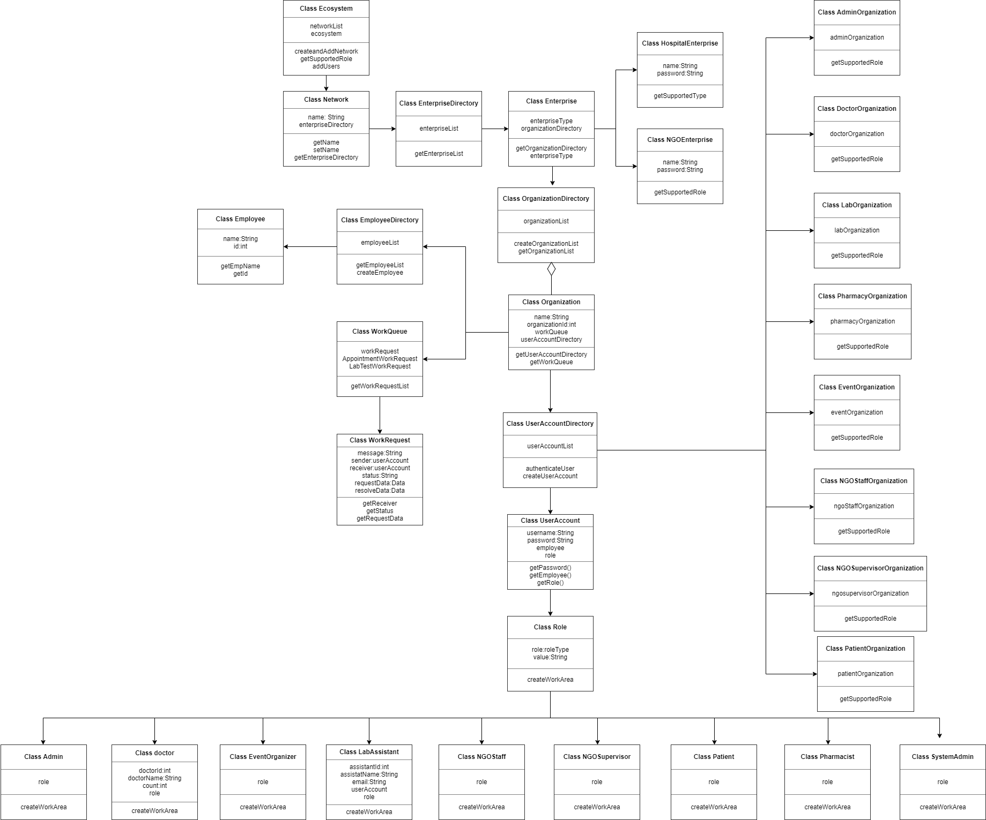
CLASS DIAGRAM

Slide 13
APPLICATION FLOW:

Slide 14
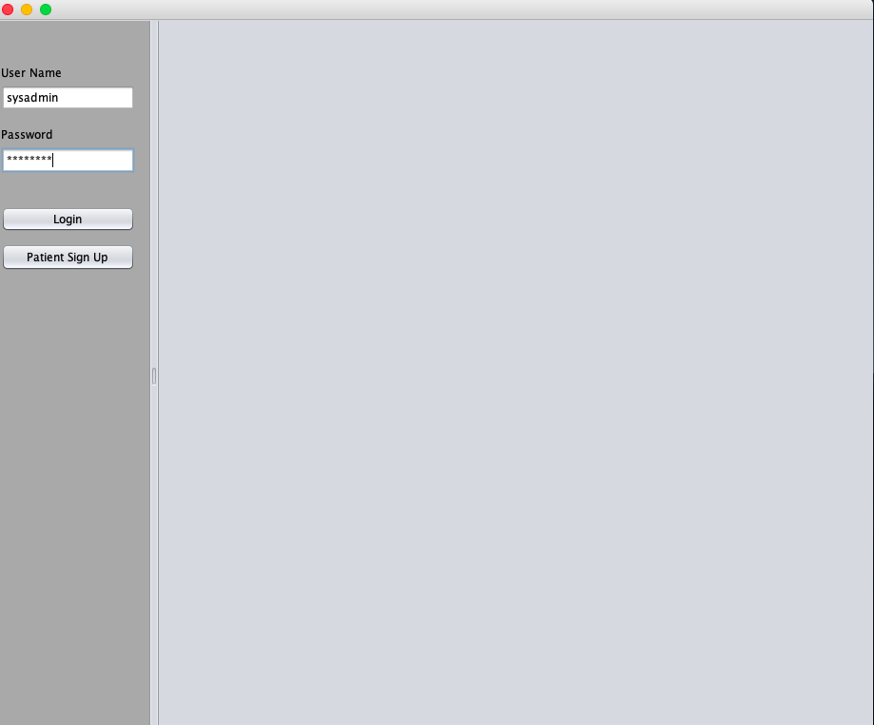
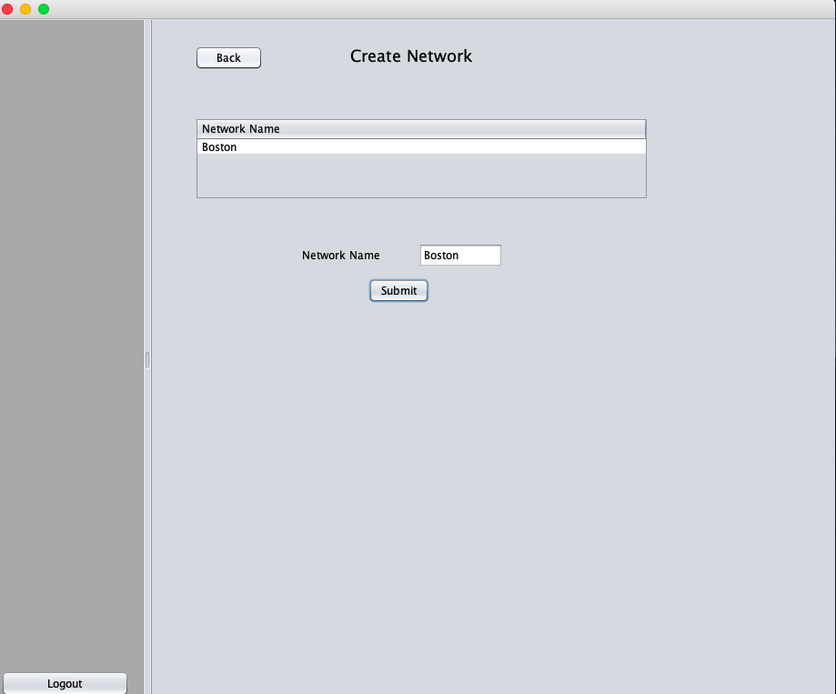
Network Creation
→

Slide 15
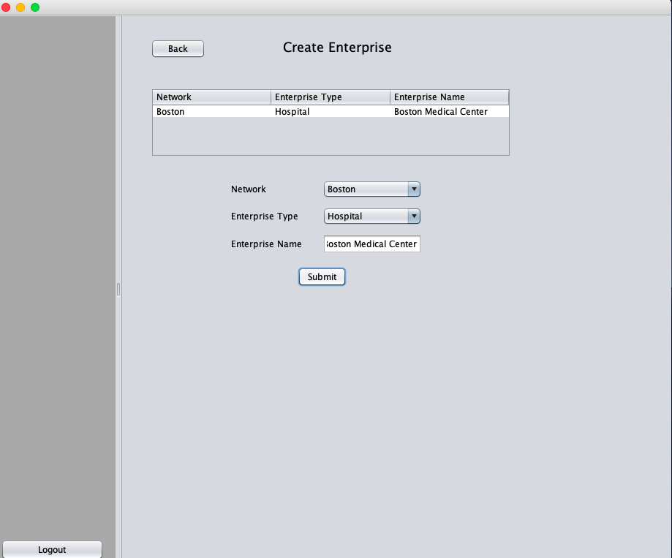
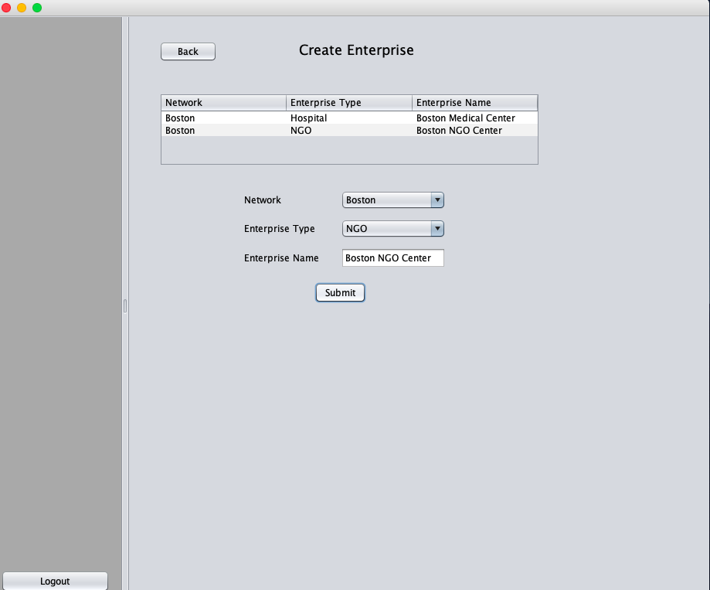
Enterprise Creation
→

Slide 16
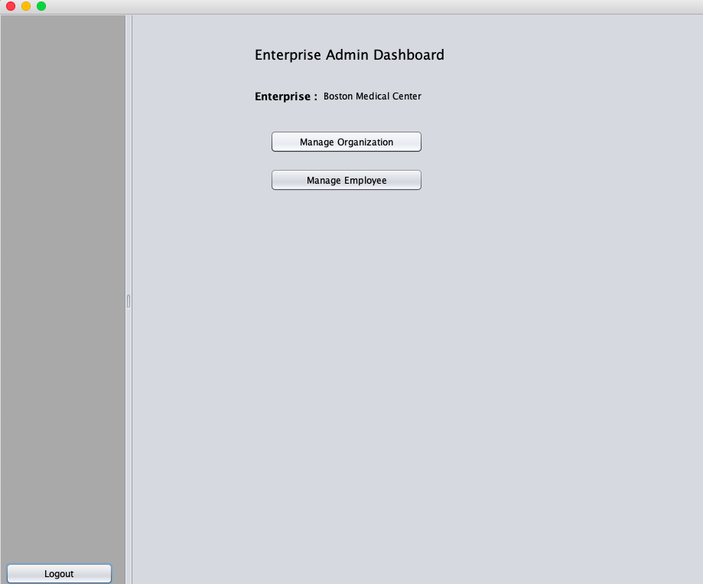
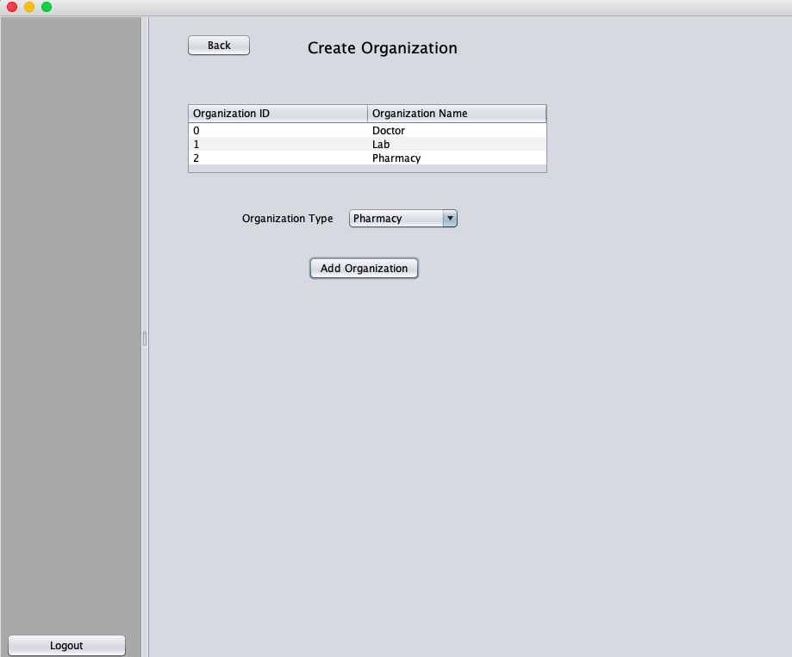
Enterprise Admin Dashboard
→

Slide 17
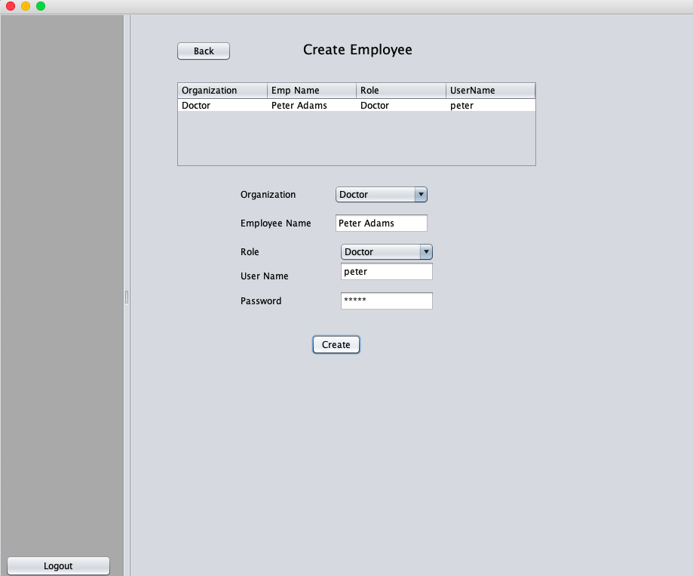
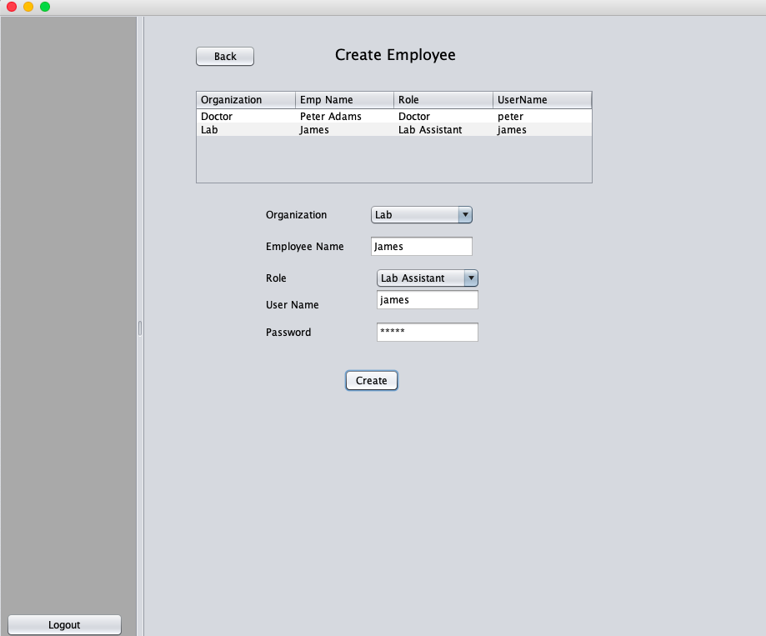
Employee Creation

Slide 18
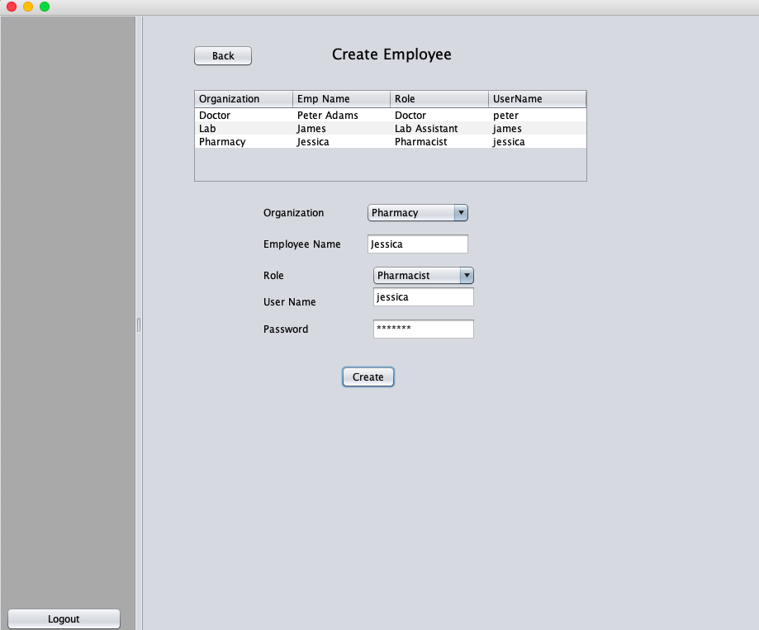
Employee Creation

Slide 19
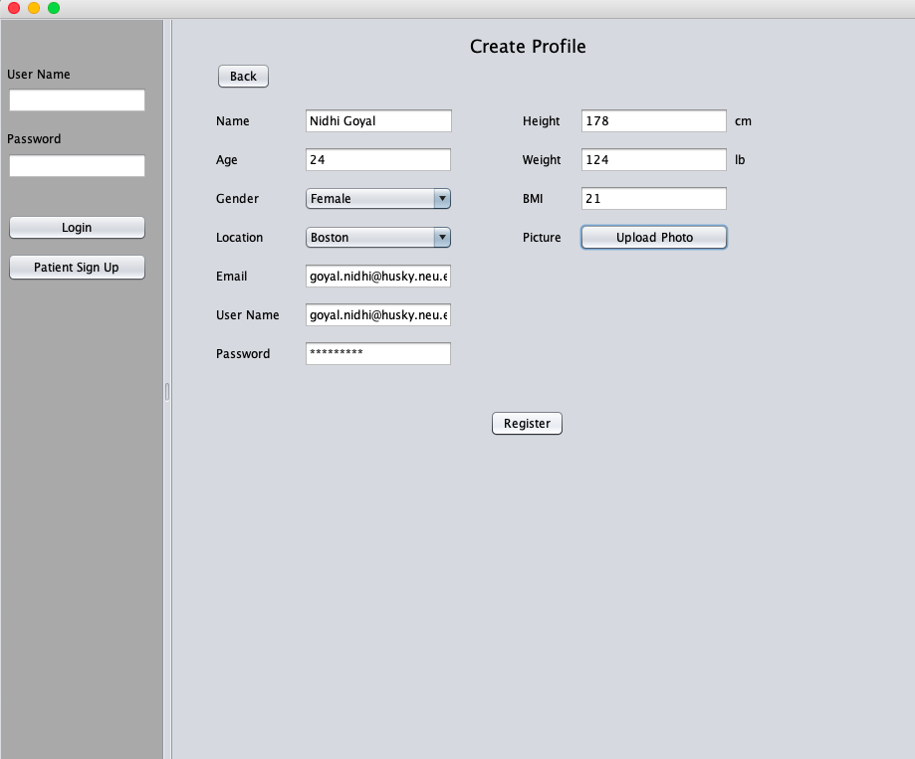
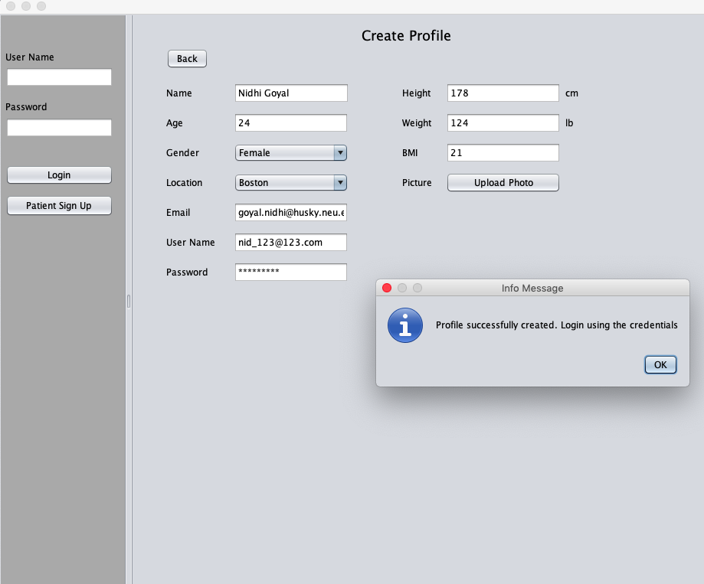
Patient Profile Creation

Slide 20
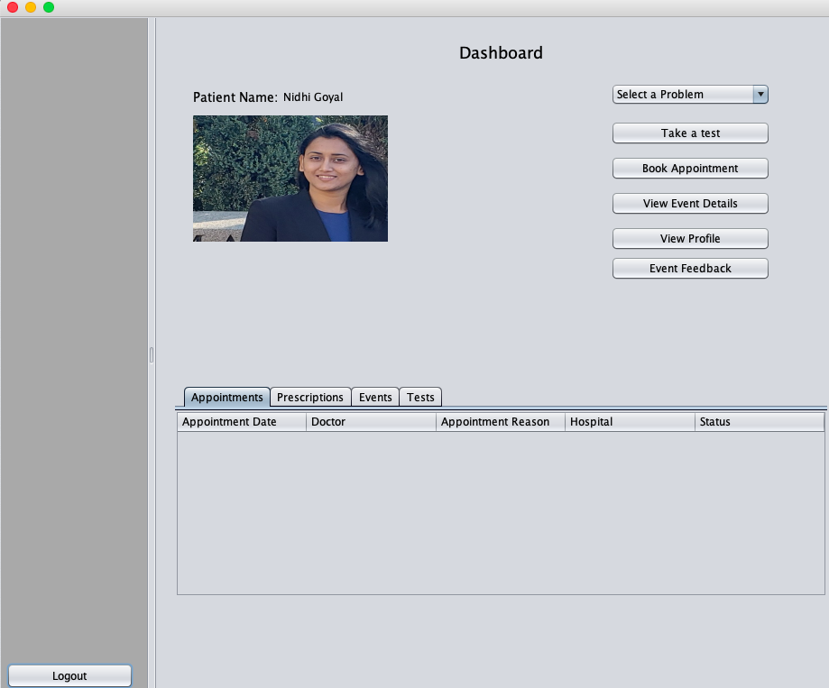
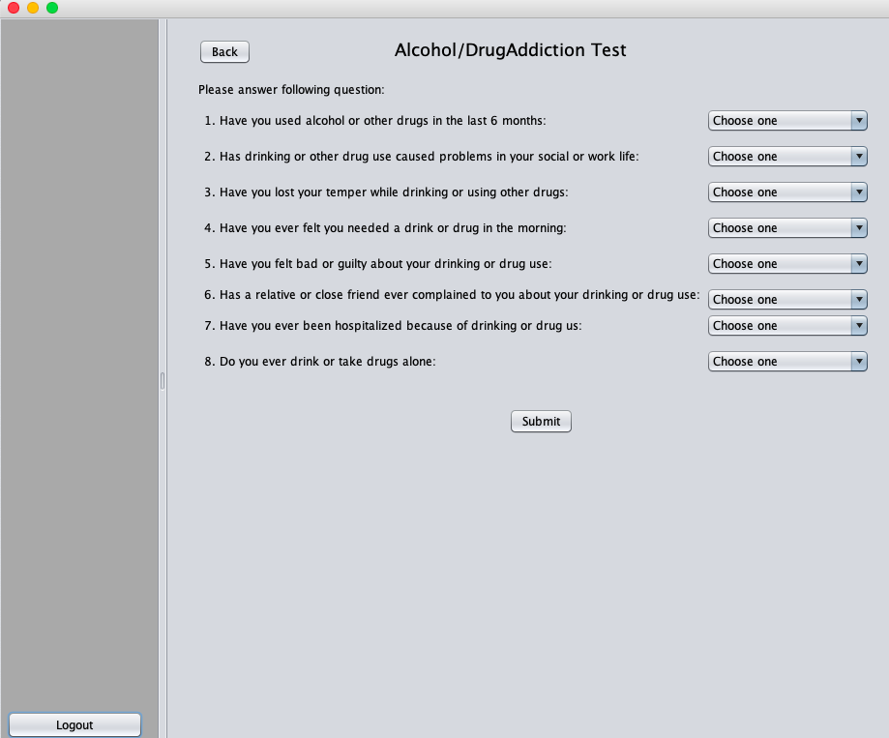
Patient Dashboard

Slide 21
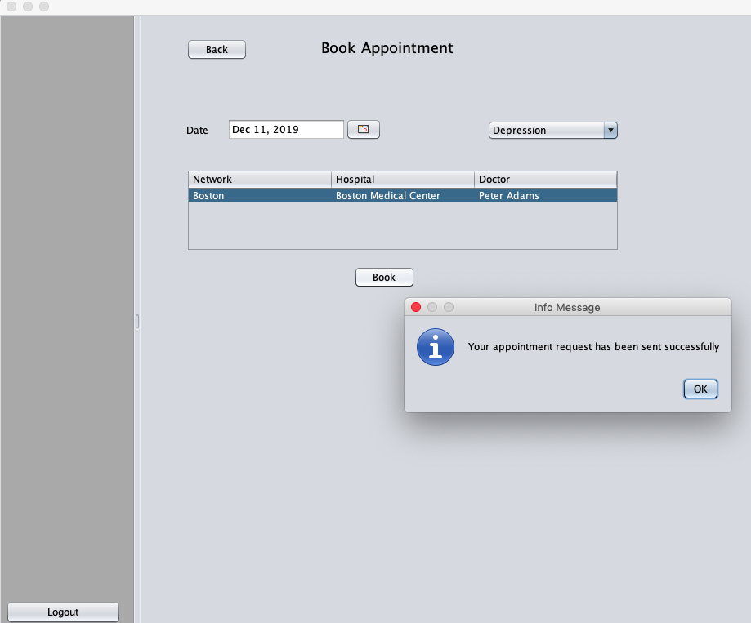
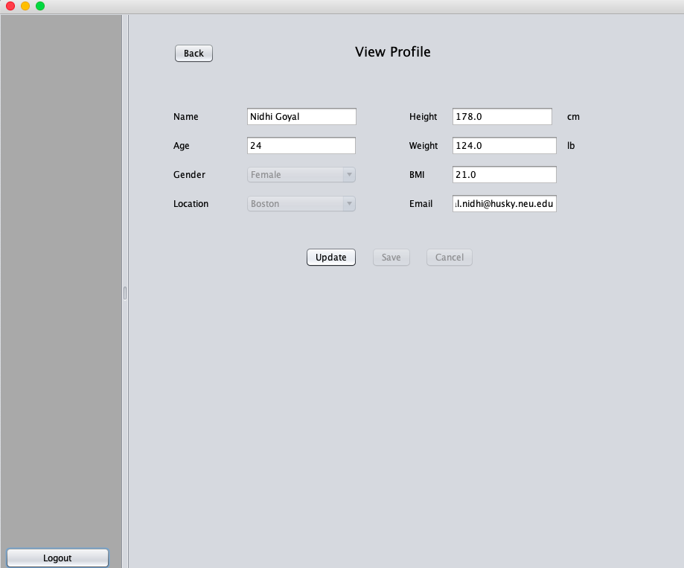
Patient Registration

Slide 22
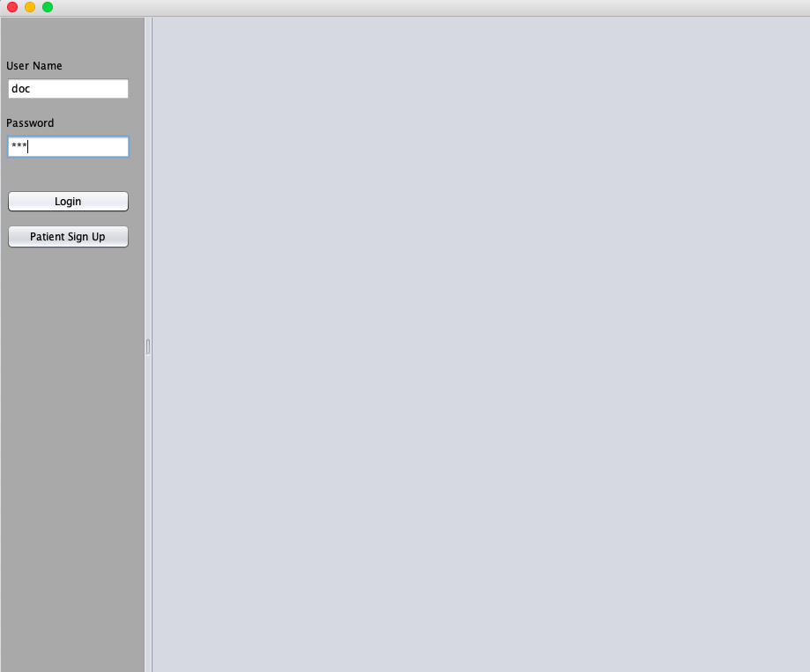
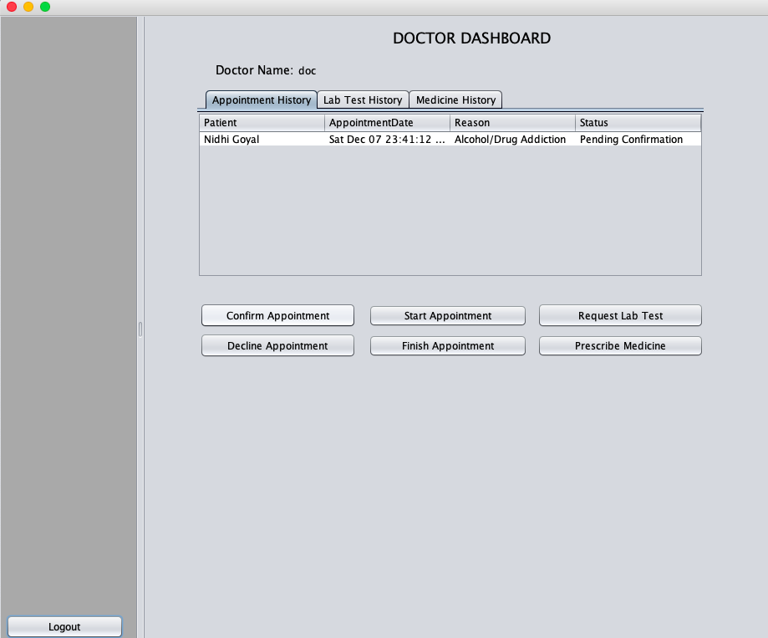
Doctor Login & Doctor Dashboard

Slide 23
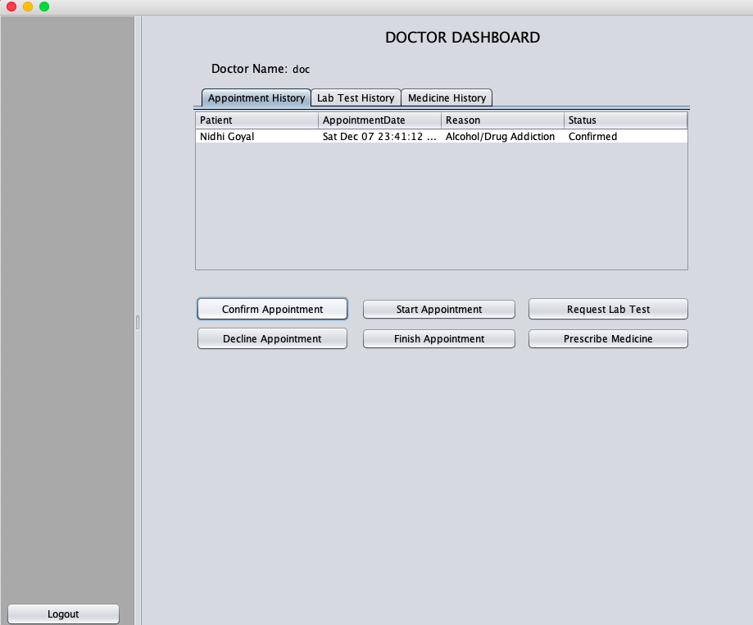
Doctor Dashboard

Slide 24
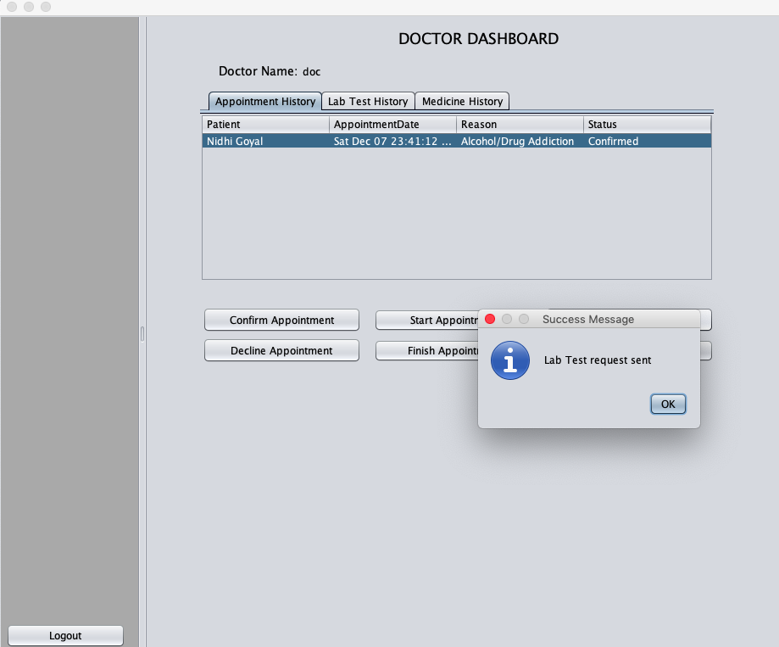
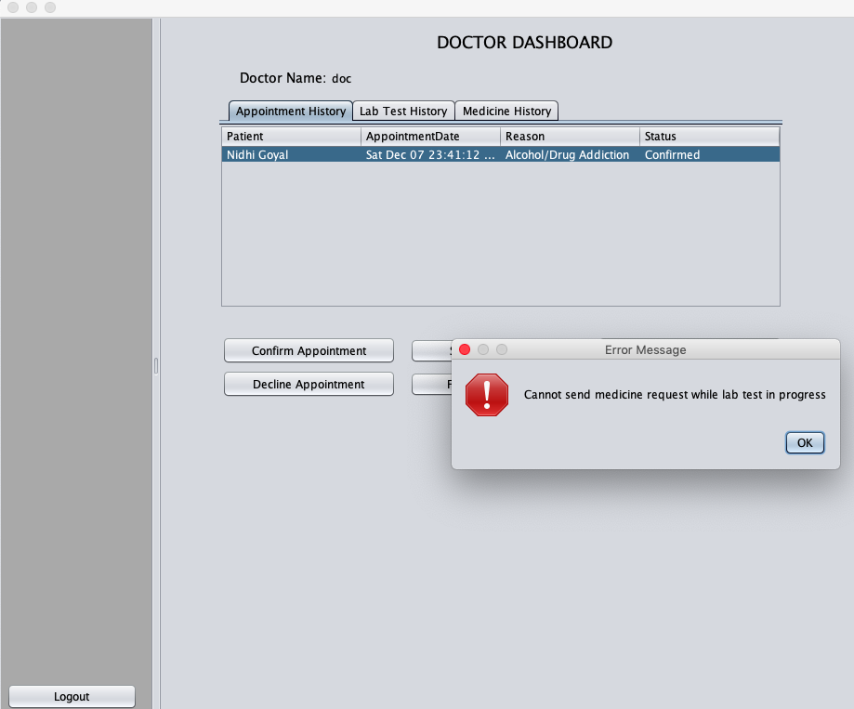

Slide 25
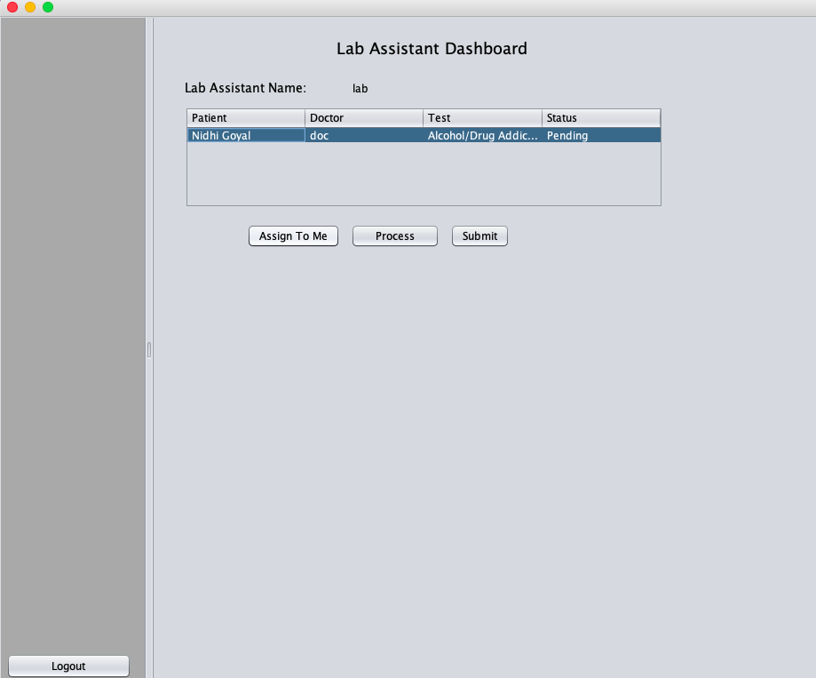
Lab Assistant Dashboard

Slide 26
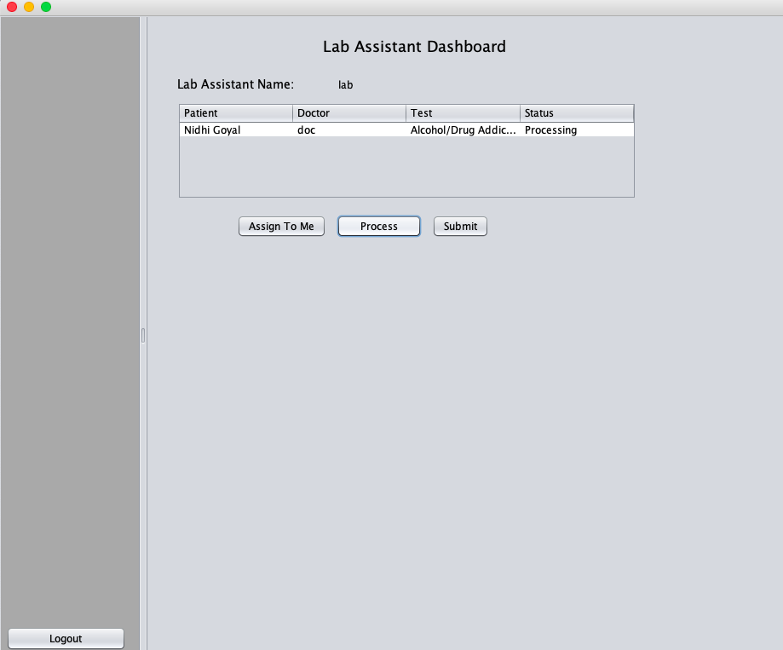
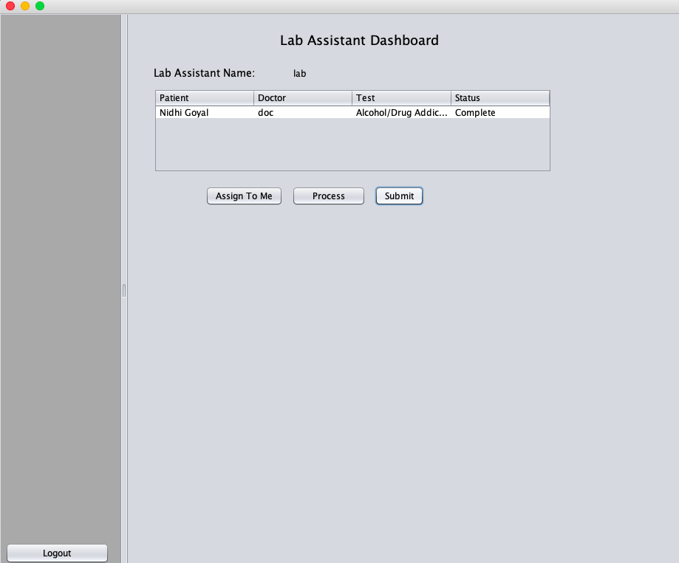
Lab Assistant Dashboard

Slide 27
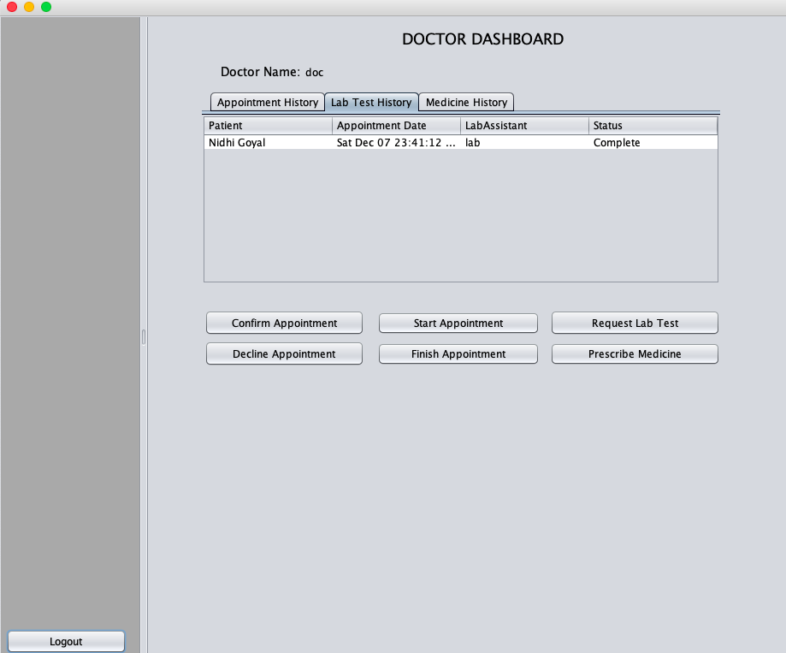

Doctor Dashboard

Slide 28
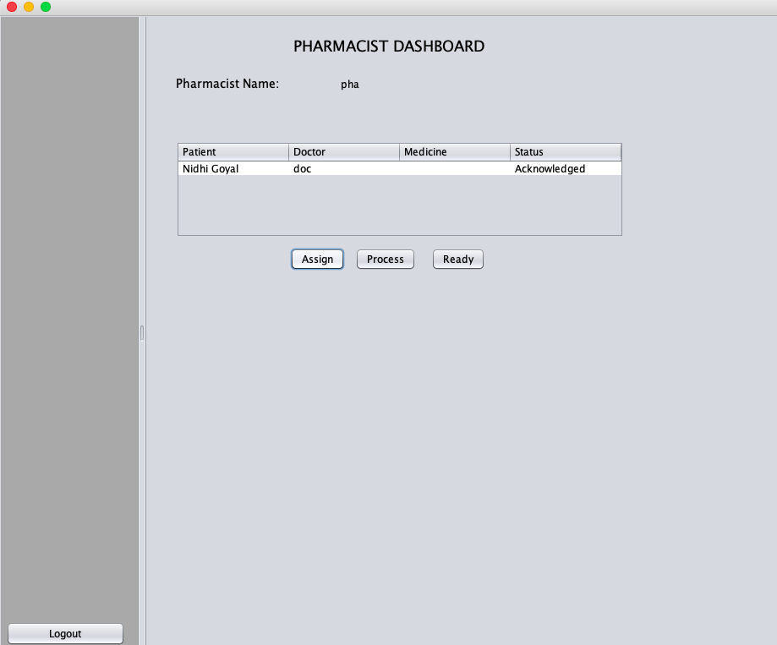
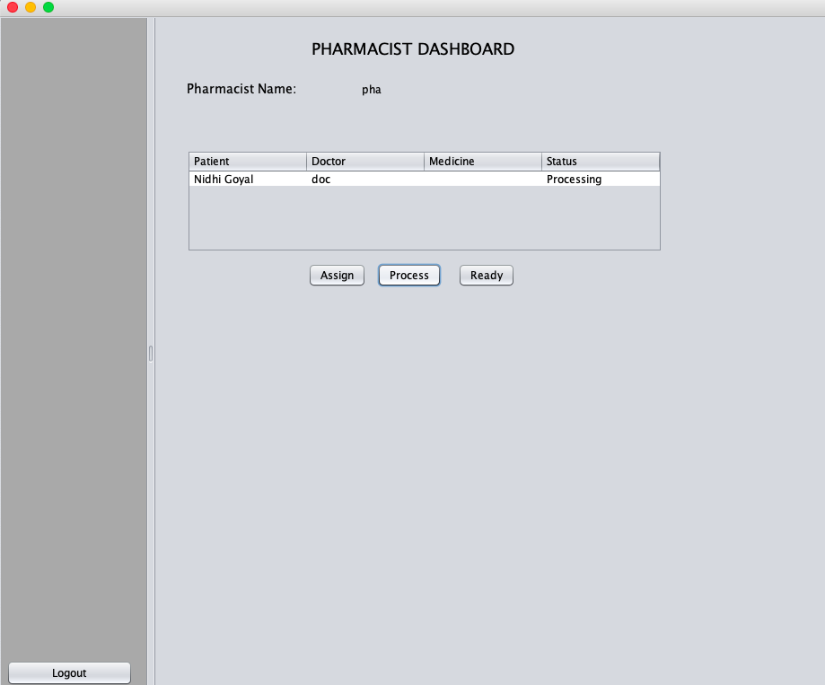
Pharmacist Dashboard

Slide 29
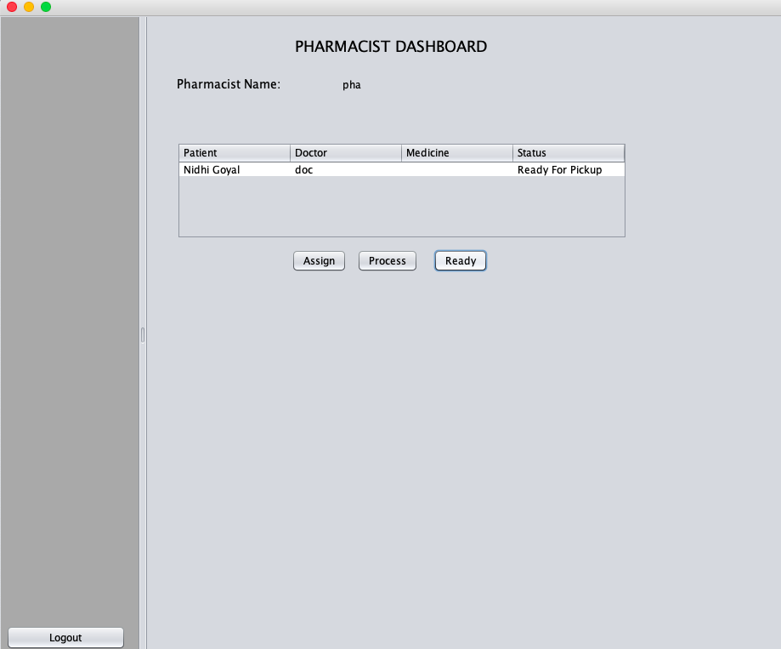
Pharmacist Dashboard

Slide 30
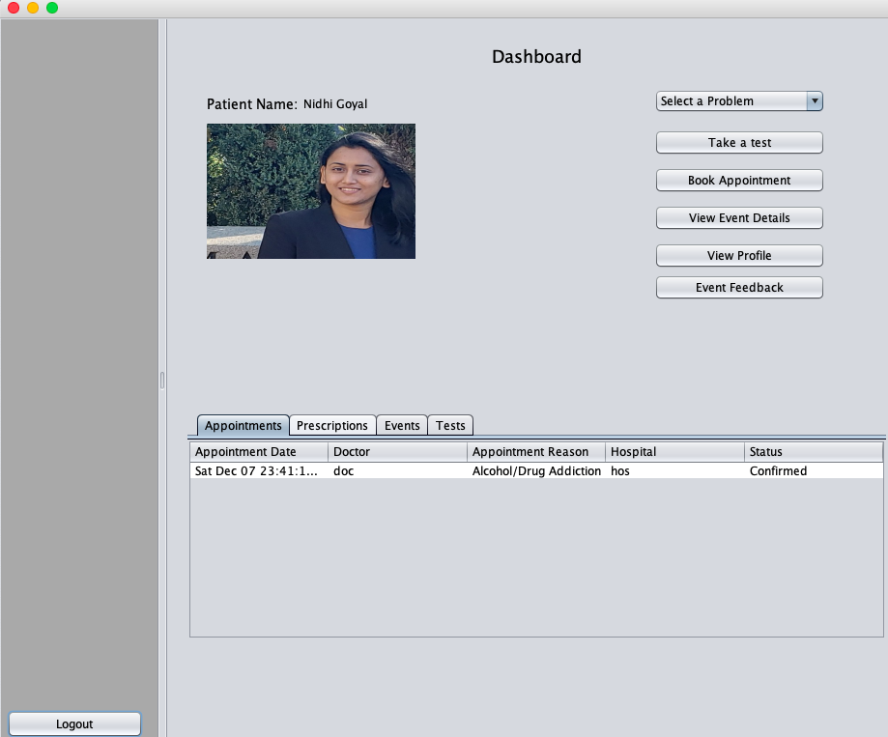
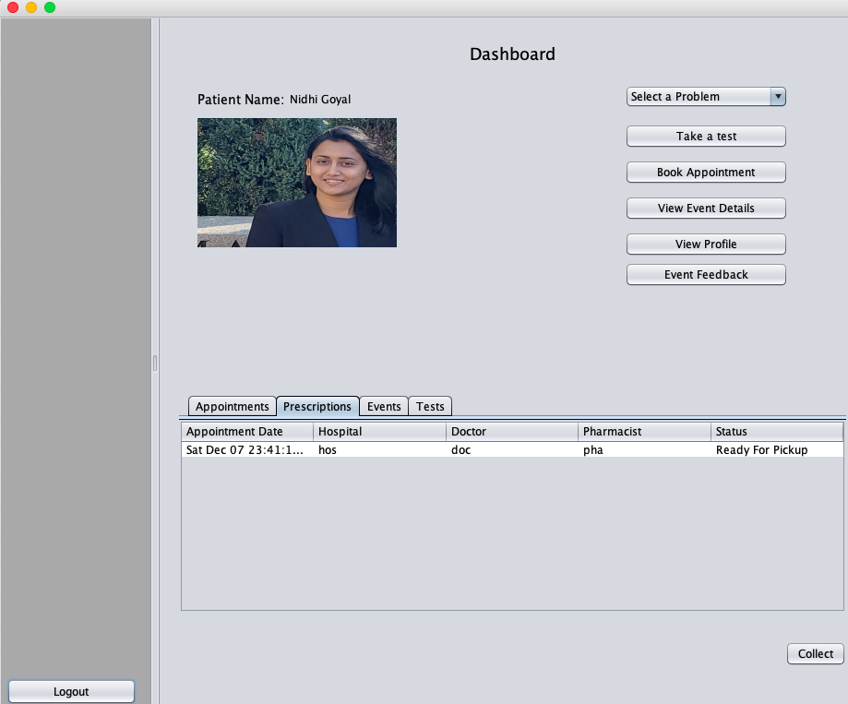
Patient Dashboard

Slide 31
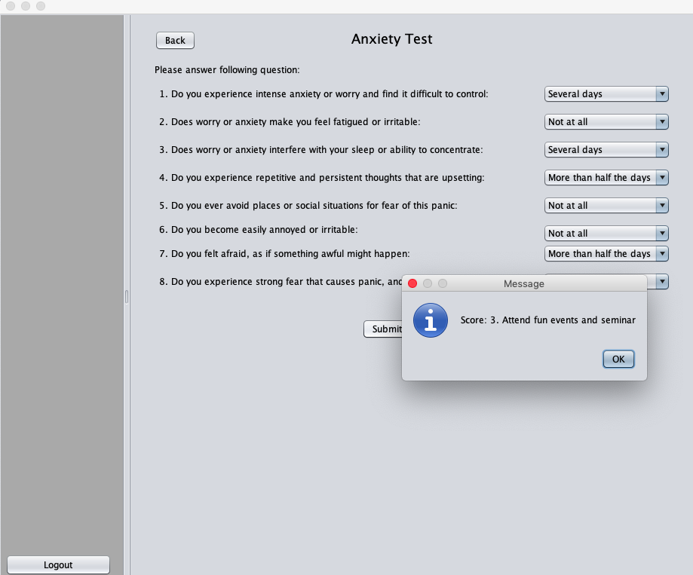
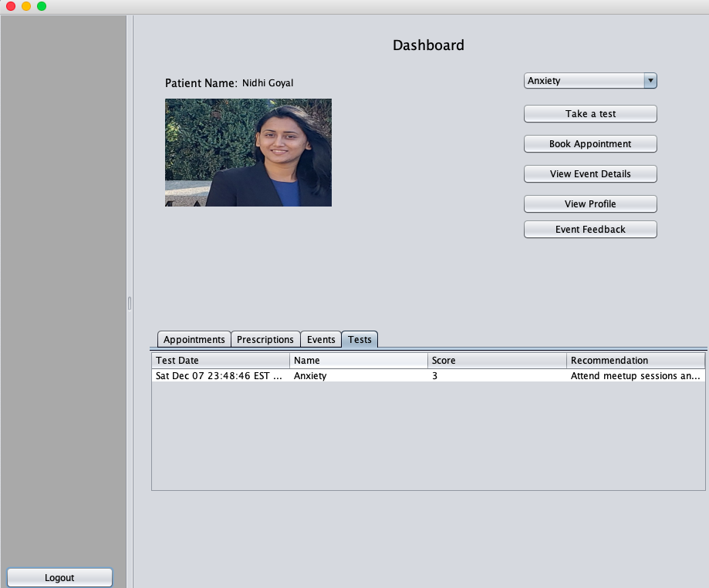
Patient Dashboard

Slide 32
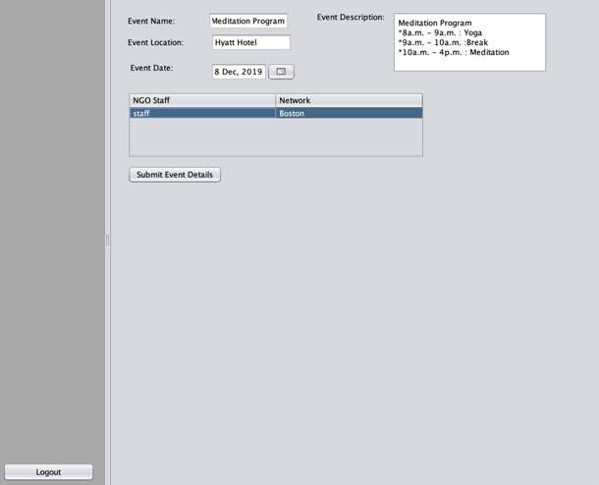
NGO Supervisor Dashboard

Slide 33
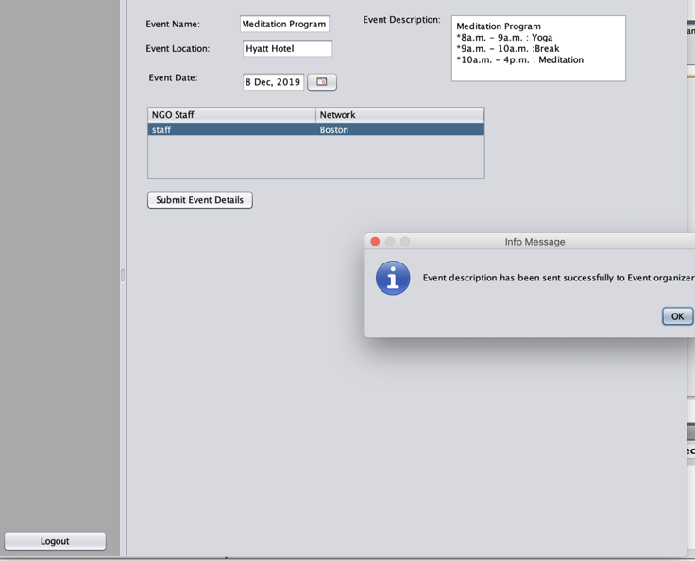
NGO Staff Dashboard

Slide 34
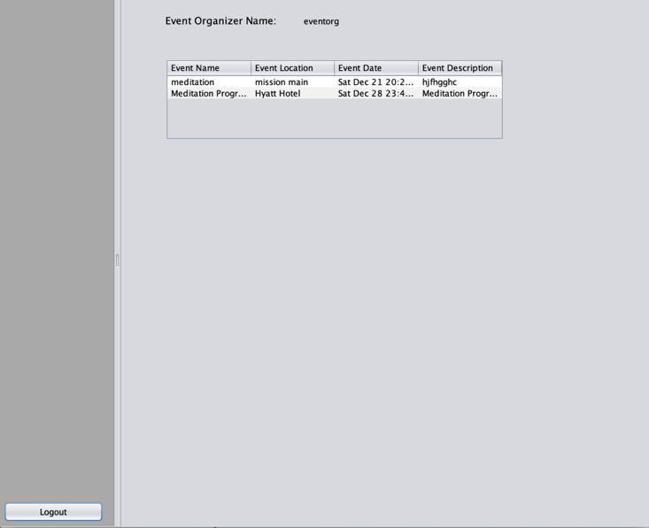
NGO Event Organizer

Slide 35
Thank You !

